Slide 1

A Major Project Review 2 Presentation on “CareerConnect: Smart Campus Placement Portal”
Presented By Abhaychandra Gupta (TU8F2122004)
Gayatri Gide (TU8F2122004)
Prajakta Chaudhari (TU8F2122010)
Harshit Mhatre (TU8F2122024) Under the Guidance of Prof. Smita Pawar

Slide 2
Outline
Introduction
Problem Statement
Literature Review
Objectives
Proposed Methodology
Progress Work

Slide 3
Introduction
The Campus Placement Portal streamlines recruitment in educational institutions by replacing manual methods with digital solutions. It uses AI and data analytics to automate job postings, student applications, and employer interactions, matching student profiles to job opportunities and providing real-time updates. The portal improves efficiency, transparency, and communication, aiding the transition from academic to professional life and helping students showcase their skills to potential employers.

Slide 4
Problem Statement
The traditional campus recruitment process is inefficient and disorganized.
Students face poor preparation resources and inconsistent resume formats.
Feedback mechanisms are inadequate, hindering student improvement.
Recruiters have limited access to comprehensive candidate information.
T&P cell members struggle with inefficient management of student profiles.
The overall placement experience is time-consuming and less effective for all parties.
There is a critical need for a unified platform to streamline and optimize the recruitment process using advanced technologies.

Slide 5
Sr. No. | Title | Problem Addressed | Methodology | Advantages | Limitations
1 | “Placement Test Web Portal” Anand Singh, Aishwarya Shukla, Maulik Sharma, Rahul Yadav, Vidyadhari Singh IOSR Journal of Computer Engineering (IOSR-JCE), e-ISSN: 2278-0661, p-ISSN: 2278-8727, pp. 58-61. Date: 02 May 2022 | Manual Inefficiency: Tedious, error-prone, and time-consuming tasks. Data Management: Inefficient manual storage, updating, and searching, risking data loss. Communication Gaps: Inefficient manual notifications can lead to missed opportunities. | Automated Student Registration Eligibility Checks Notification System Sentiment Analysis Resume Builder Mock Tests and Performance Tracking | Data Integrity Enhanced Communication Performance Tracking Feedback Integration Cost-Effective Scalability | Technical Dependency Initial Setup Maintenance User Training Integration Challenges Sentiment Analysis Accuracy

Slide 6
Sr. No. | Title | Problem Addressed | Methodology | Advantages | Limitations
2 | "Implementation of Training and Placement System" Aishwarya Baile, Pratik Sawarkar, Pratik Wankhede International Journal of Scientific Research in Science and Technology, Online ISSN: 2395-602X, Volume 8, Issue 3, May-June 2021. | Manual Inefficiency Data Management Communication Gaps Lack of Automation | Web Application Development Database Management Automated Notifications Eligibility and Application Management Admin and Company Interface | Efficiency Data Integrity Improved Communication User-Friendly Scalability Continuous Improvement | Initial Implementation Cost Technical Challenges User Adoption Maintenance Dependency on the Internet

Slide 7
Sr. No. | Title | Problem Addressed | Methodology | Advantages | Limitations
3 | “Placement Hive AI-based Placement Portal” Preksha Nigam, Dr. Ashok Yadhav, Mohammad Ahmad YMER, ISSN: 0044-0477, Volume 22, Issue 04 (April) – 2023. | Automate and streamline recruitment processes Replace manual processes with AI-driven technologies Utilize natural language processing Integrate chatbots for enhanced interaction Apply predictive analytics for better decision-making | Natural Language Processing (NLP) Chatbots Predictive Analytics Deep Learning Algorithms | Automates manual tasks, reducing time and effort in candidate screening Enhances precision of candidate-job matching, leading to better hires Lowers recruitment costs associated with manual processes | Accuracy of predictions relies on data quality and completeness Requires significant upfront investment in AI technologies and infrastructure Integration of AI technologies can pose challenges in deployment and maintenance

Slide 8
Sr. No. | Title | Problem Addressed | Methodology | Advantages | Limitations
4 | “SMART PREP: Smart Preparation Web Application for Placements Using Machine Learning.” Prasanna Kandekar, Manjiri Raut, Shravani Kadam. International Research Journal of Engineering and Technology (IRJET), Volume 11, Issue 03, March 2024. | Fragmented Resources Lack of Personalization Limited Feedback Privacy Concerns Scalability Challenges | Requirement Analysis System Design Data Collection and Preprocessing Machine Learning Model Development Integration of Key Features | Personalized Learning Experience Efficient Preparation Comprehensive Resource Availability Real-Time Feedback and Performance Analysis Enhanced Decision Making | Limited integration of all potential AI/ML techniques Dependence on user feedback for validation Potential bias in AI algorithms Requires significant data for accuracy

Slide 9
Sr. No. | Title | Problem Addressed | Methodology | Advantages | Limitations
5 | "Placement Analysis for Students using Machine Learning" C. M. Nalayani, Thanga Akilan .V, Hariharan .S. Journal of Information Technology and Digital World, June 2023, Volume 5, Issue 3, Pages 223-227. | Uncertainty in student placement outcomes Need for metrics to assess placement progress Factors affecting academic performance Predicting placement status of students | Machine learning algorithms (Random Forest, Decision Tree, K-means clustering) Data mining techniques including Naïve Bayes Binary logistic regression model Naïve Bayes and K-Nearest Neighbour algorithms | Predicts placement outcomes effectively Provides a structured approach to placement analysis Identifies significant factors affecting performance High accuracy with multiple parameters considered | Requires accurate and comprehensive data input Relies on historical data for predictions Limited to specific factors analyzed May not cover all influencing factors

Slide 10
Sr. No. | Title | Problem Addressed | Methodology | Advantages | Limitations
6 | "Placement Automation System For Educational Institutes." Piyush Deore, Pranav Chougule, Atharva Dere. IJCRT, Volume 11, Issue 5, May 2023, ISSN: 2320-2882. | Repetitive application process for students Lack of analysis features for TPOs and coordinators Absence of student authorization in existing systems Difficulty in managing large databases | Automated data collection and management Implementation of user authentication Use of NLP and ML models for chatbot Implementation of filtering algorithms | Reduces manual work and errors in data handling Easy updating and tracking of student placements Ensures legitimacy of student data Improved interaction and assistance for students | Manual processes still exist in some areas Limited features for historical data analysis May require additional setup for user verification Chatbot may still struggle with complex queries

Slide 11
Sr. No. | Title | Problem Addressed | Methodology | Advantages | Limitations
7 | "Automatic question generation and answer assessment: a survey." Bidyut Das, Mukta Majumder, Santanu Phadikar. Research and Practice in Technology Enhanced Learning, 2021, 16:5. | Need for automated assessment in e-learning Difficulty in assessing learner's answers Lack of effective tools for subjective question evaluation Insufficient understanding of existing methods | Overview of question generation and assessment techniques Use of various datasets for question generation Comparison of question types and difficulty levels Automated tools for scoring written answers | Facilitates self-learning and identifies gaps Reduces labor and time in question generation Improves accuracy in learner assessment Helps teachers manage large volumes of assessments | Challenges in evaluating subjective questions Inadequate datasets for generating MCQs Limited accuracy in subjective answer evaluation Current methods may not achieve adequate results

Slide 12
Sr. No. | Title | Problem Addressed | Methodology | Advantages | Limitations
8 | "Real-Time Facial Expression Recognition Using Convolutional Neural Network." AMr. L. Sivaprasad, E. Giribabu Goud, V. Harshitha. IJCRT, Volume 11, Issue 4, April 2023, ISSN: 2320-2882. | Real-time facial expression recognition Processing video frames for emotion detection Identifying facial expressions Comparison with state-of-the-art methods | Convolutional Neural Networks (CNN) and OpenCV Training on large datasets of facial images Use of wavelet transform for precision Evaluation using precision, recall, F1 score | Accurate and fast emotion recognition Suitable for various practical applications Improved accuracy in facial emotion detection Real-time performance enhancement | Dataset limitations affect performance Generalization ability may vary with datasets Hyperparameter tuning can be complex Architecture may limit scalability

Slide 13
Sr. No. | Title | Problem Addressed | Methodology | Advantages | Limitations
9 | "Campus Placement Prediction – AI ML." Abhinav Velaga, Vemula Gayathri, Satish Chandran. IJCRT, Volume 12, Issue 3, March 2024, ISSN: 2320-2882. | Insufficient data leading to overfitting Ethical considerations in data handling Lack of relevant features influencing success Data acquisition challenges | AI and ML-driven model using student data Algorithms like Decision Trees and Neural Networks Feature importance analysis Data cleaning and preprocessing | Personalized feedback for students and recruiters Streamlined selection process Potential paradigm shift in traditional placement Enhanced model reliability and fairness | Data quality and availability issues Bias and fairness concerns in ML models Interpretability and explainability challenges Limitations in data access and representativeness

Slide 14
Sr. No. | Title | Problem Addressed | Methodology | Advantages | Limitations
10 | "Facial Expression and Sound Analysis for Interview Assessment: An AI-Based Application." Dhanashri Anwat, Prajakta Derle, Payal Nagare. JETIR, April 2024, Volume 11, Issue 4. | Lack of structured opportunities for interview practice in educational settings Challenges faced by recent graduates in preparing for job interviews Uncertainty about performance and areas for improvement during interviews. | Multimodal data acquisition including video and audio data capture. Real-time analysis of user behavior and emotions using AI technologies Integration of a social virtual character as a recruiter in the simulation. | Provides personalized feedback highlighting strengths and weaknesses. Enhances social skills essential for job interviews through simulation | Subjective nature of interviews complicates assessment Dependence on technology may limit accessibility for some users May not fully replicate the unpredictability of real-life interviews

Slide 15
Sr. No. | Title | Problem Addressed | Methodology | Advantages | Limitations
11 | "Resume Matching Framework via Ranking and Sorting Using NLP and Deep Learning." Lav Kumar, Karthik Penikalapati, Sudheer Kumar Reddy Gowrigari. IRJMETS, Volume 05, Issue 11, November 2023. | Inefficient matching of resumes to job postings Manual screening and keyword-based searches Lack of semantic understanding in traditional methods | Utilizes NLP and Deep Learning techniques Preprocessing resumes and job descriptions Ranking and sorting based on relevance scores | Saves time and resources for HR professionals Improves accuracy and efficiency of matching Streamlines hiring process for employers Enhances job seekers' chances of finding relevant jobs | Ethical and fairness considerations Potential bias in data and algorithms Requires continuous monitoring for fairness Integration with existing HR systems may be complex

Slide 16
Sr. No. | Title | Problem Addressed | Methodology | Advantages | Limitations
12 | "Smart Resume Analyser: A Case Study using RNN-based Keyword Extraction." Patlolla Sruthi, P. N. V. K. G. Adithya, MD. Suleman. E3S Web of Conferences, ICMPC 2023, 23, 010 (2023). | Inefficient resume screening process Difficulty in identifying qualified candidates Time-consuming resume modification Unstructured data processing challenges | Utilizes NLP and ML for resume analysis RNN-based keyword extraction Generates suggestions for resume optimization | Reduces recruiter workload Automates extraction of relevant information Shortens recruitment time Identifies keywords, patterns, and trends | Does not provide recommendations for skill enhance Limited to matching conditions set by recruiters Lacks personalized recommendations for courses

Slide 17
Objective
Shorten recruitment time and reduce selection bias by ranking candidates based on multiple resume aspects.
Analyze key factors driving student placement success using insights from ML models.
Leverage advanced AI/ML models to improve assessment accuracy and provide detailed insights into candidate capabilities.
Implement a confidence assessment algorithm using webcam data.
Develop a matching algorithm that aligns candidate performance and preferences with suitable companies, streamlining the recruitment process.

Slide 18
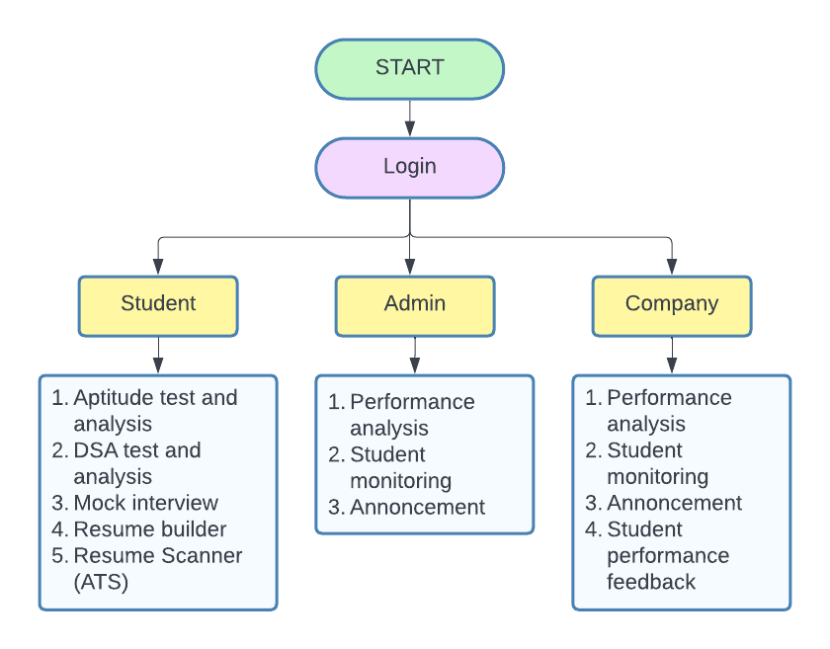
Flowchart
Figure 1: Flowchart of portal

Slide 19
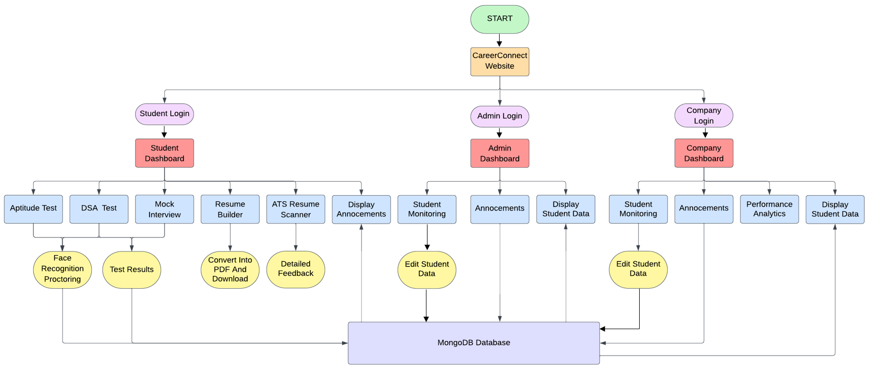
Figure 2: Architecture of portal

Slide 20
Proposed Methodology
1. Aptitude Test:
UI & Quiz Management: Uses Streamlit to display questions and capture answers.
Proctoring: Implements OpenCV’s Haar Cascade algorithms for real-time face and eye detection to monitor test integrity.
Data Logging: Stores test results and proctoring violations in MongoDB.
2. DSA Test:
Coding Interface: Integrates a code editor (Streamlit Ace) for multi-language support.
Execution & Evaluation: Runs user code via subprocess calls, comparing outputs to test cases.
Data Tracking: Logs submissions and performance metrics in MongoDB.
3. Mock Interview:
Question Generation: Uses Google Generative AI to create tailored interview questions.
Answer Capture & Evaluation: Accepts both typed and recorded answers (via speech recognition) and provides AI-generated feedback.
Proctoring: Monitors the interview using Haar Cascade-based face and eye detection, logging violations.

Slide 21
4. Resume Builder:
Form-Based Data Entry: A web form built with HTML, Bootstrap, and JavaScript collects personal, educational, and professional details.
Dynamic Elements: Allows adding multiple experiences or projects.
PDF Generation: Uses jsPDF (and Axios for backend processing) to convert form data into a downloadable resume PDF.
5. Resume Scanner ATS:
PDF Processing: Converts the first page of a PDF resume into an image (using pdf2image) and encodes it in base64.
AI Analysis: Leverages Google Generative AI to evaluate the resume against a job description, extracting keywords and calculating a match percentage.
Caching: Uses Streamlit caching to optimize repeated API calls.

Slide 22
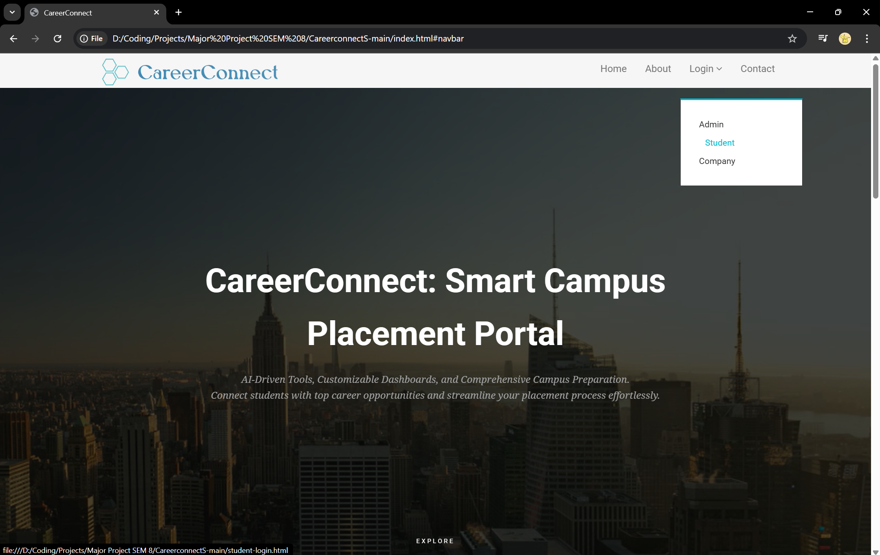
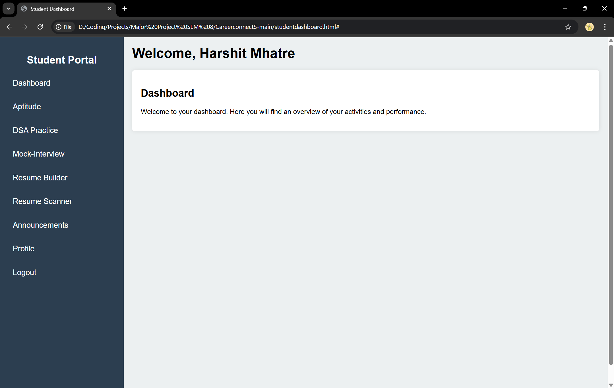
Progress Work
Figure 1.1 Home page
Figure 1.2 Student dashboard

Slide 23
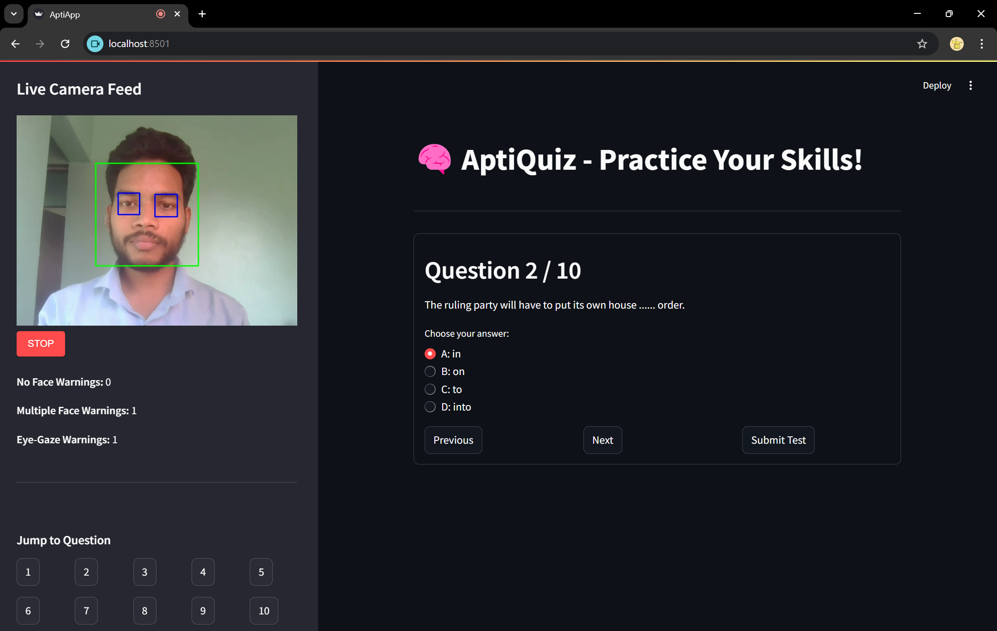
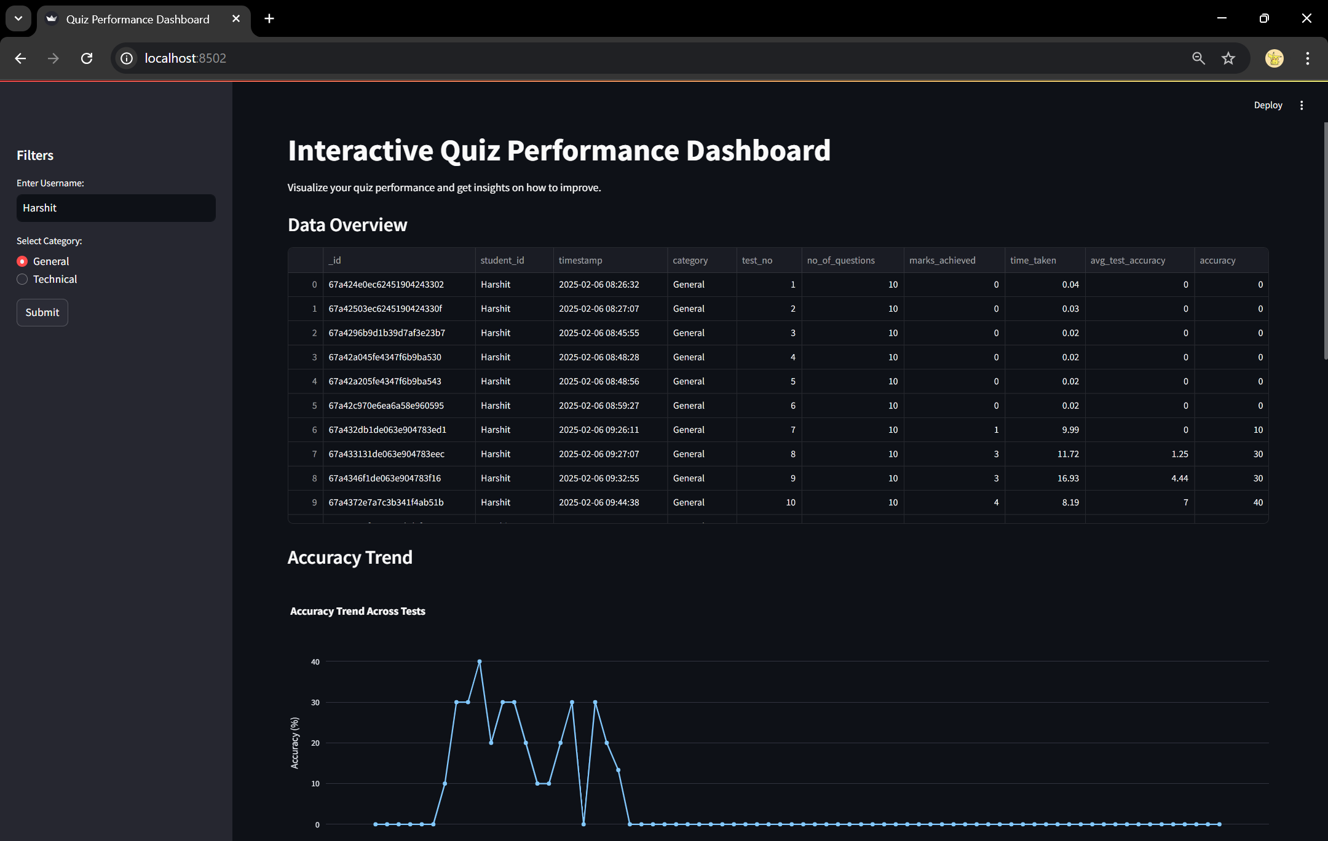
Fig 1.3 Aptitude test
Fig 1.4 Aptitude test analysis and visualization

Slide 24
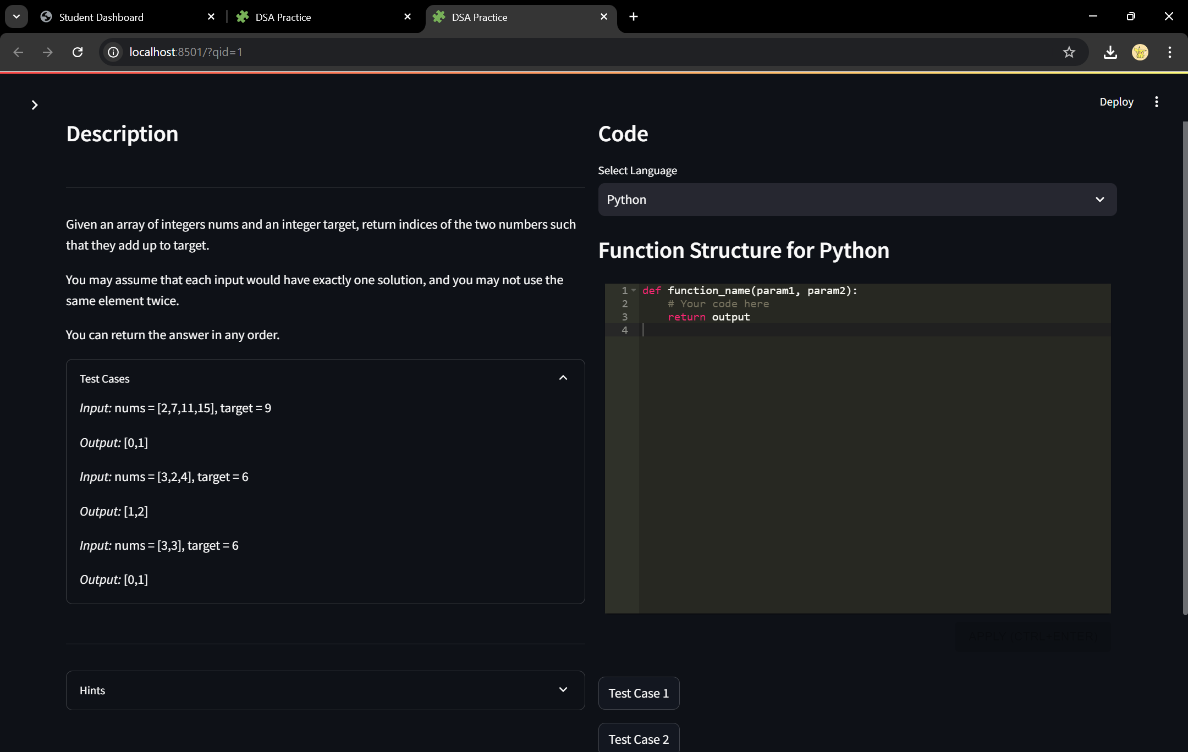
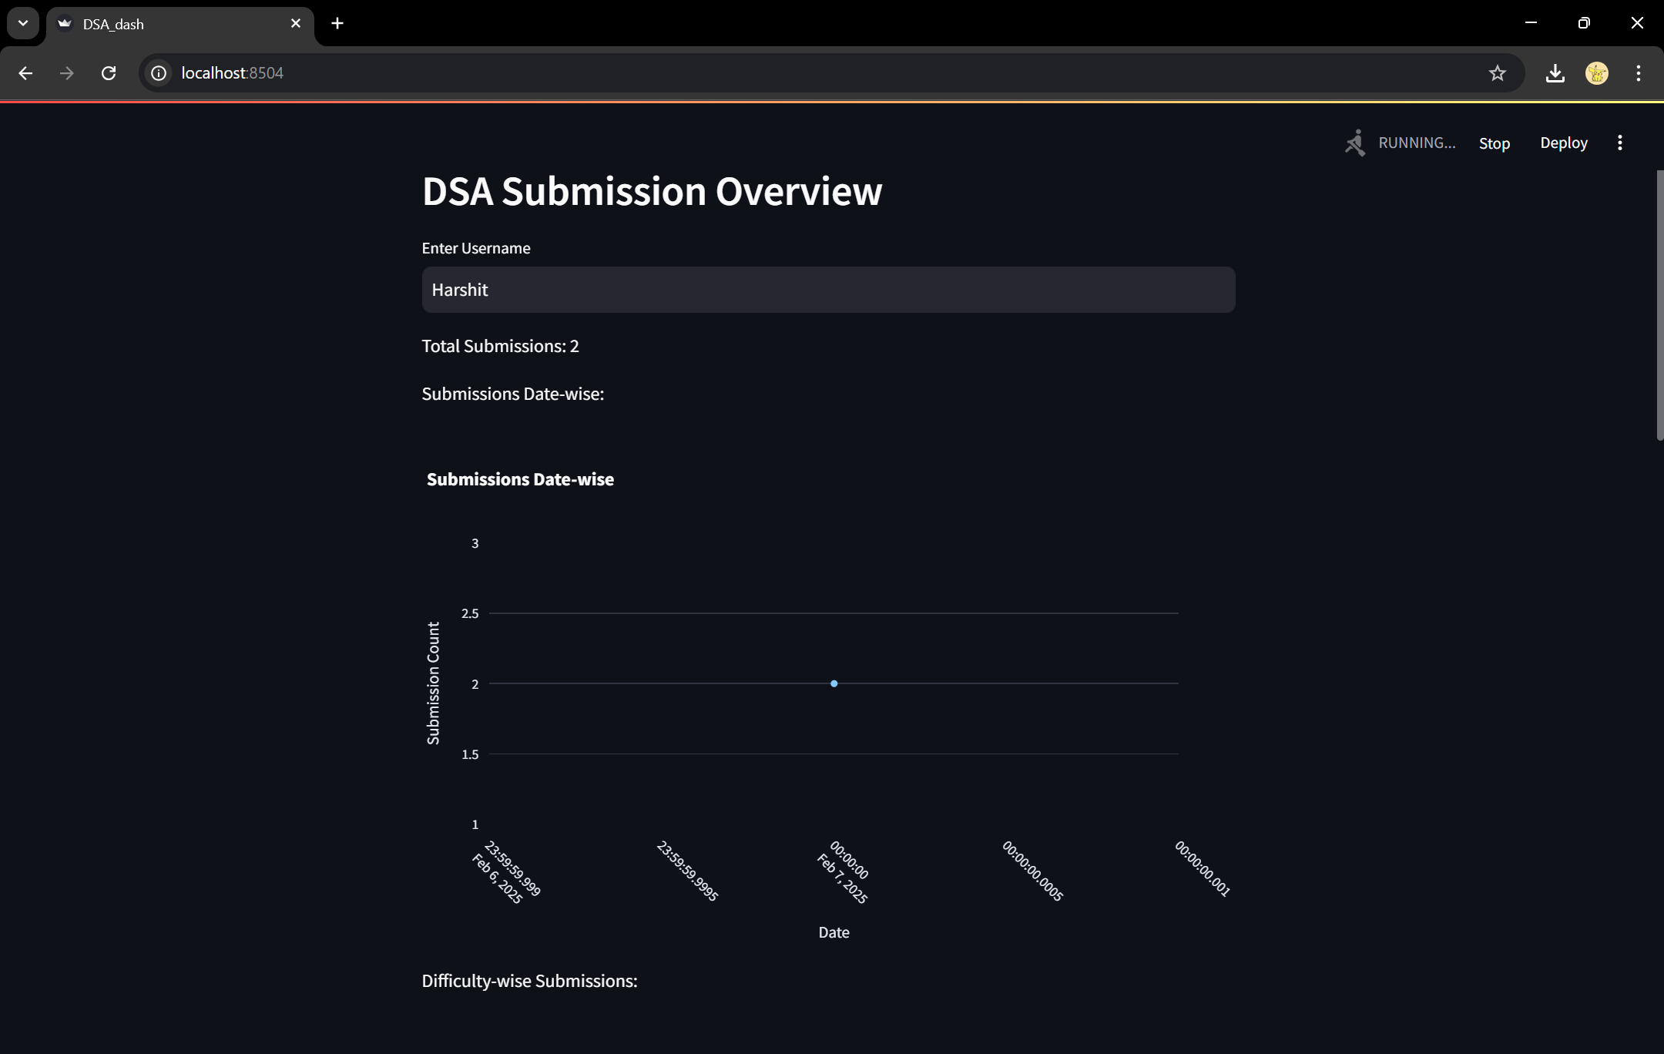
Fig 1.5 DSA test
Fig 1.6 DSA test analysis and visualization

Slide 25
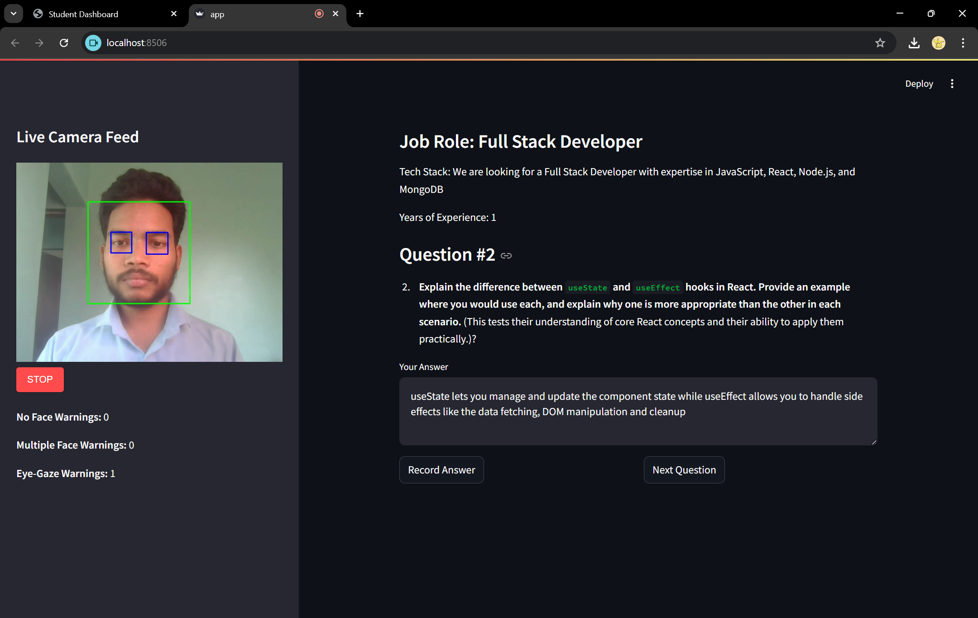
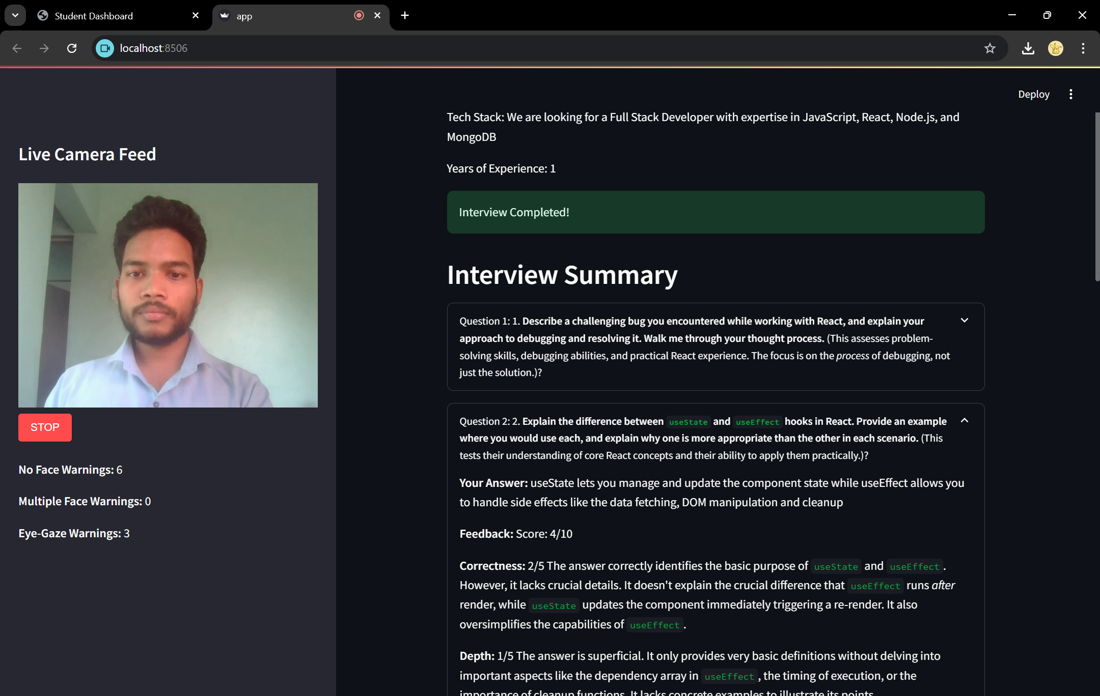
Fig 1.7 Mock interview
Fig 1.8 Mock interview summary

Slide 26
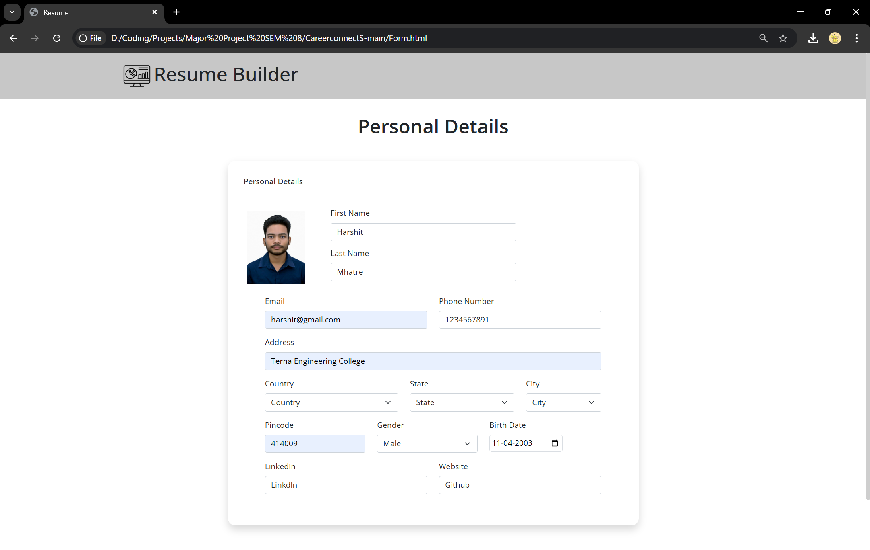
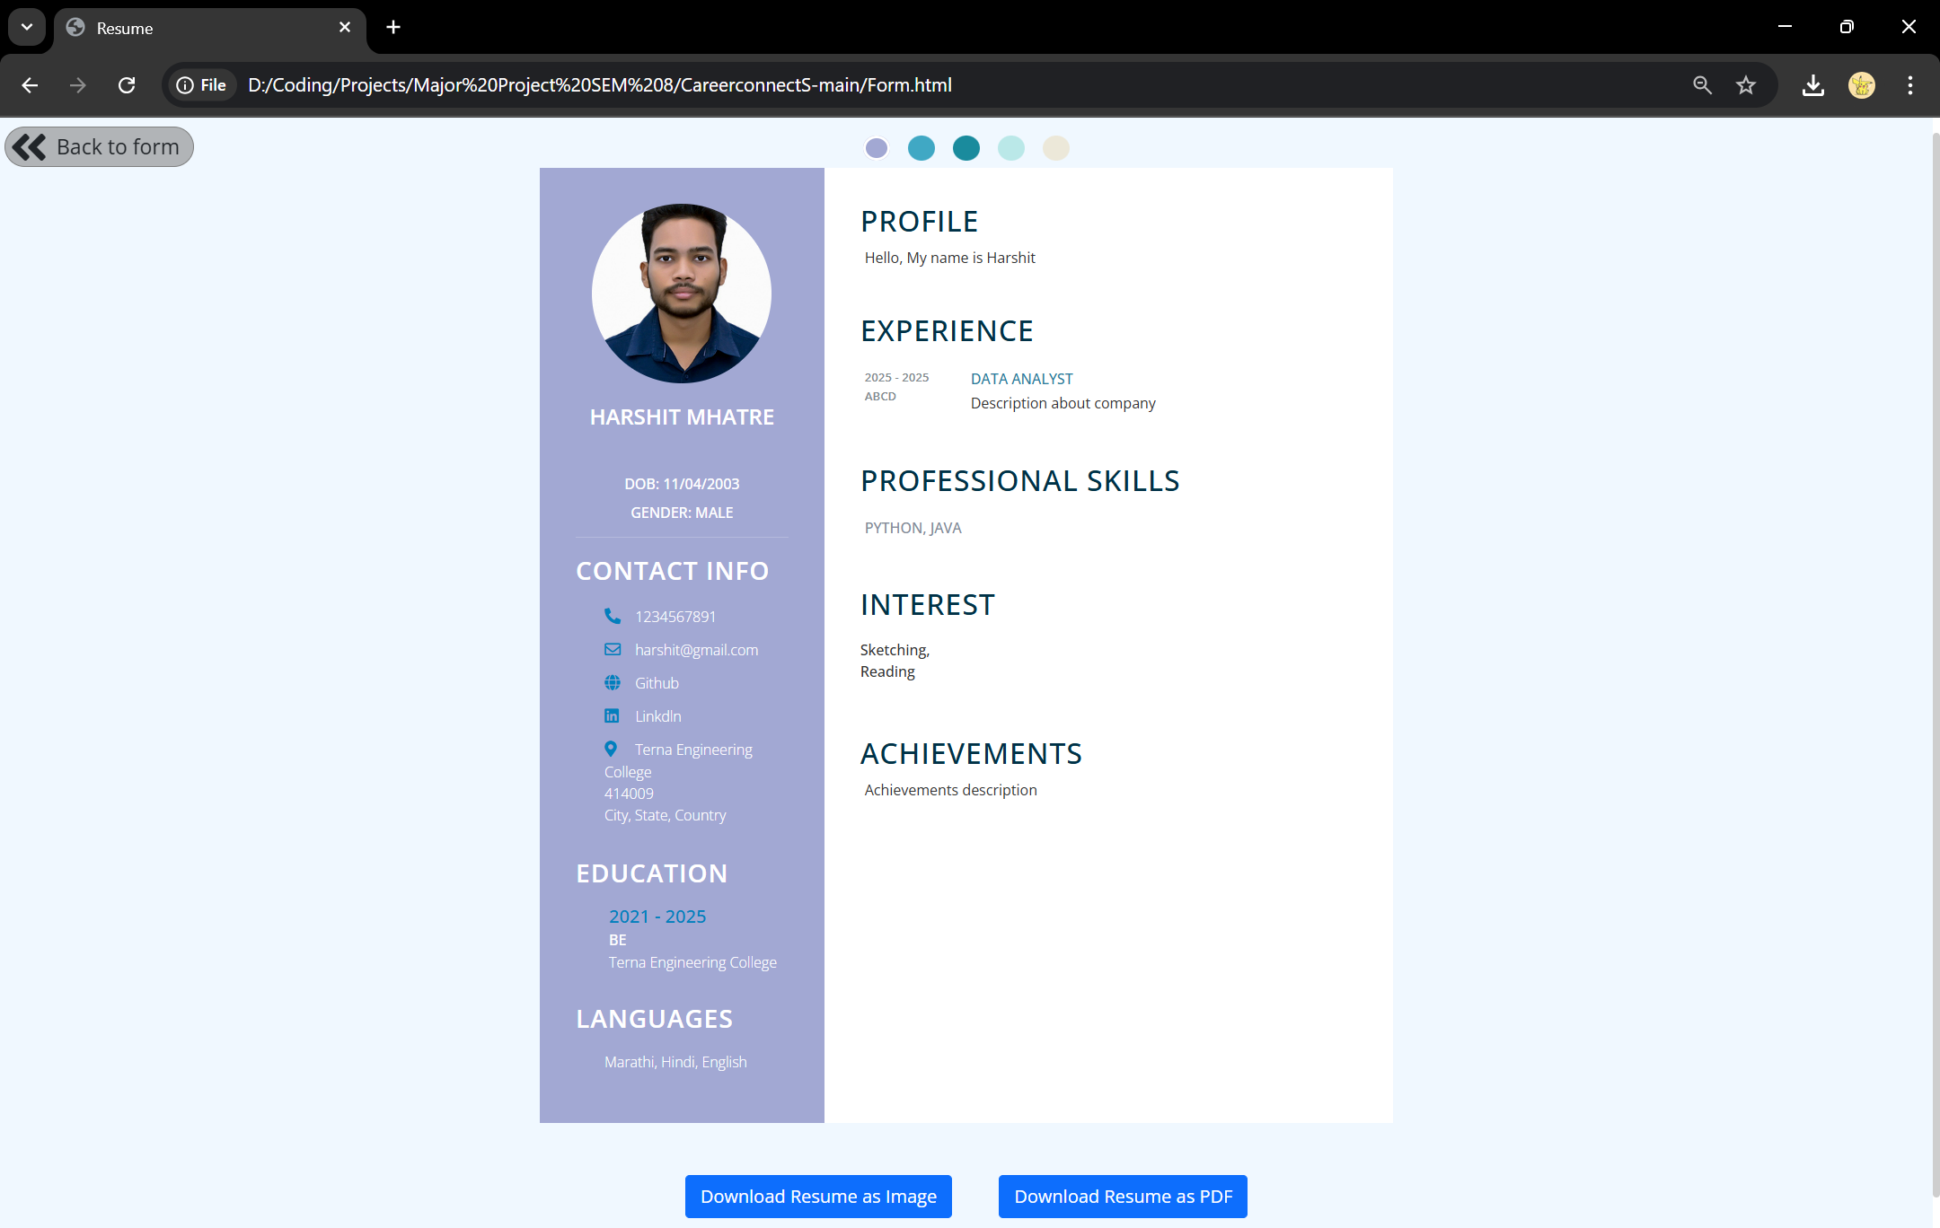
Fig 1.9 Resume builder
Fig 1.10 Resume builder output

Slide 27
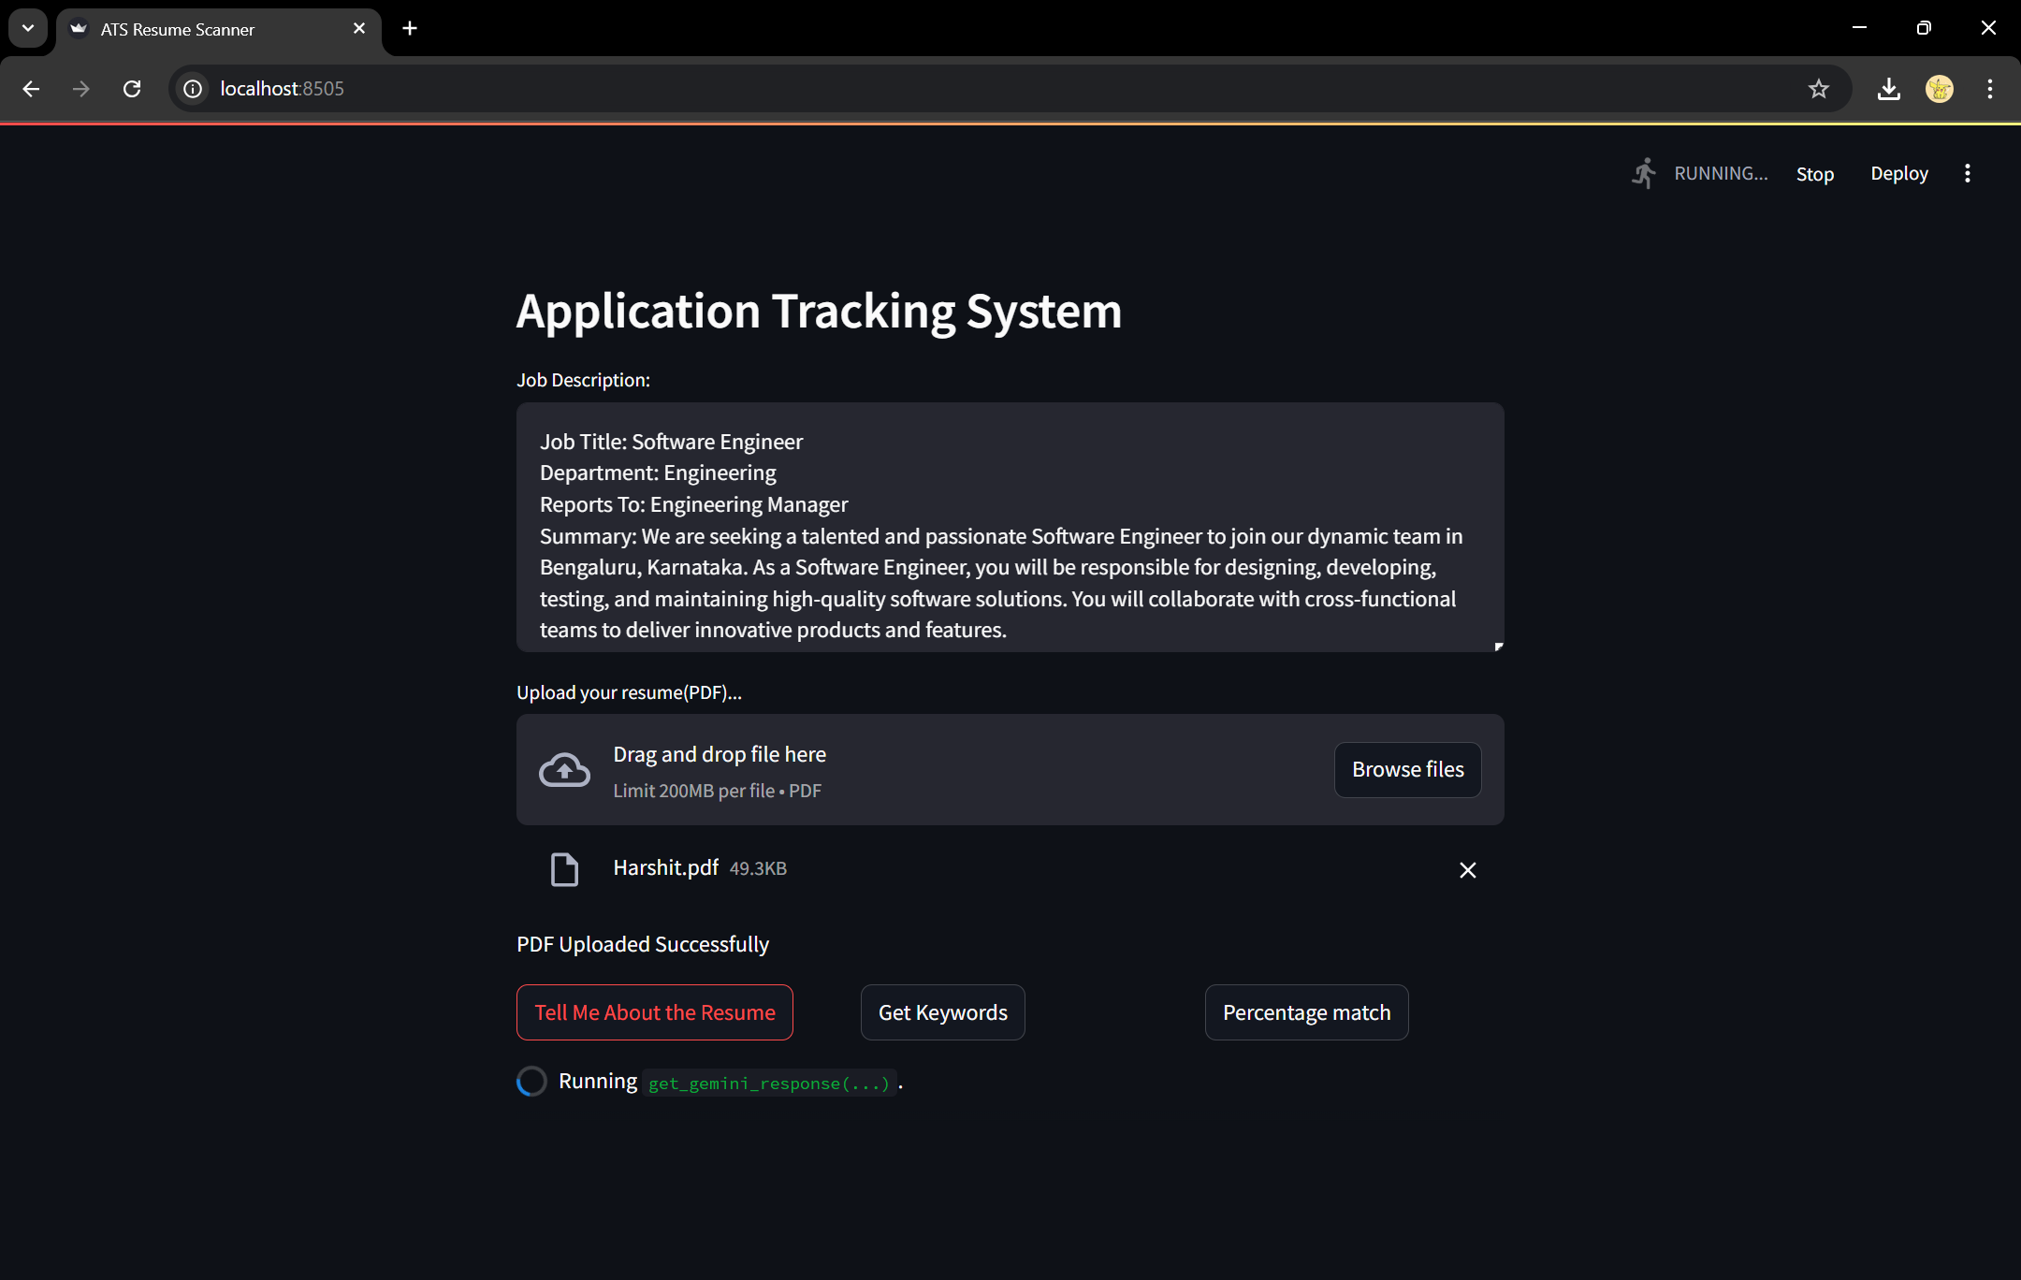
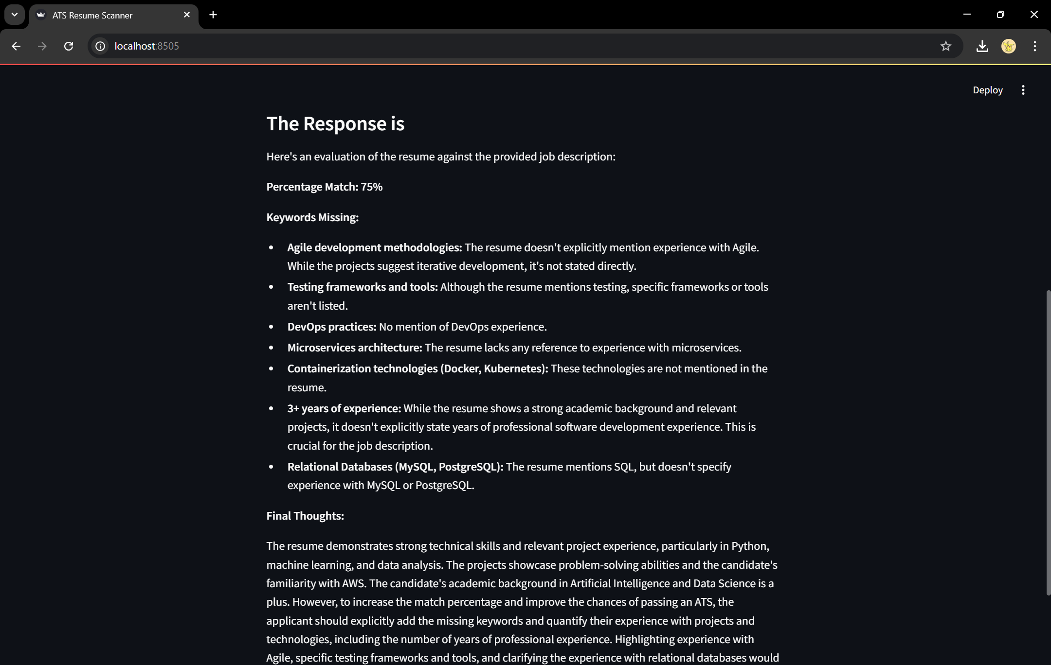
Fig 1.11 Resume scanner ATS
Fig 1.12 Resume scanner response

Slide 28
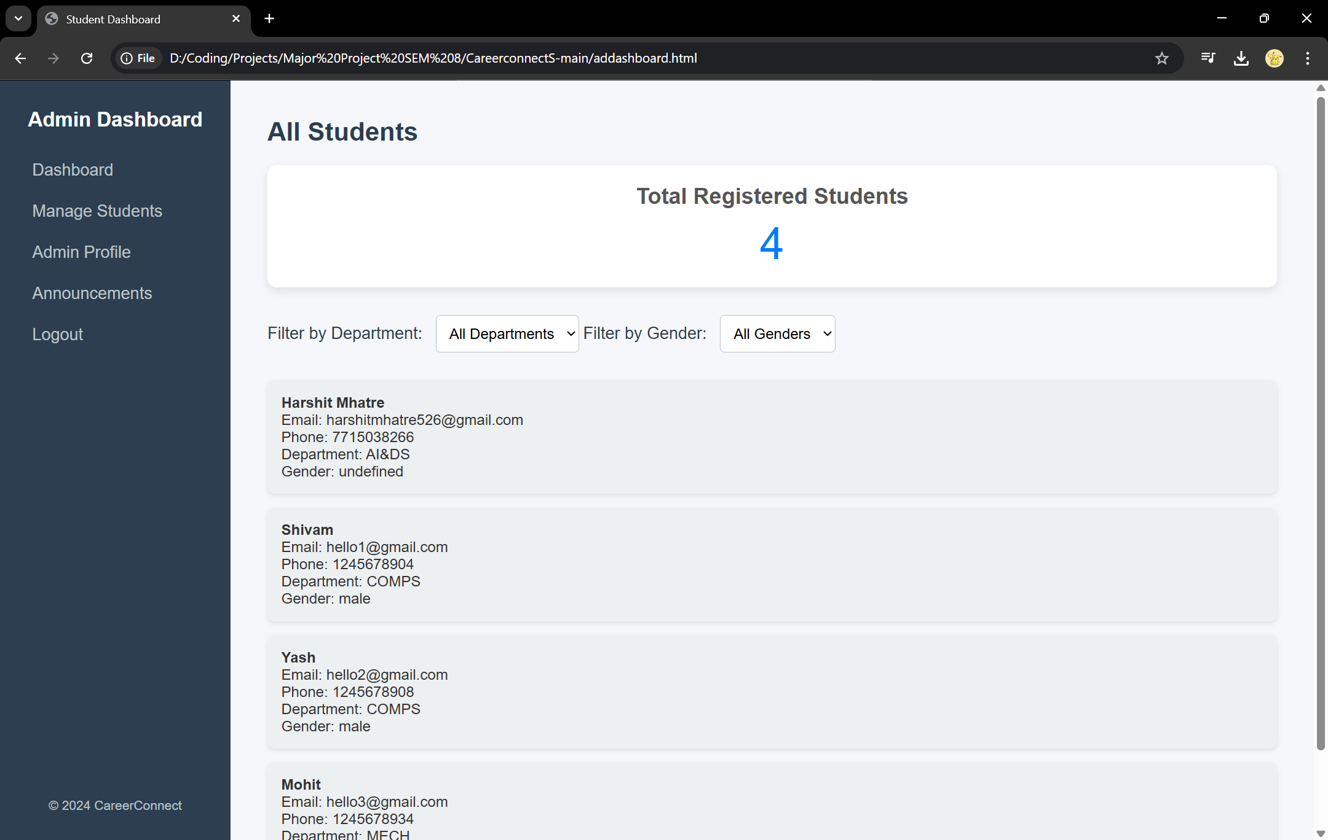
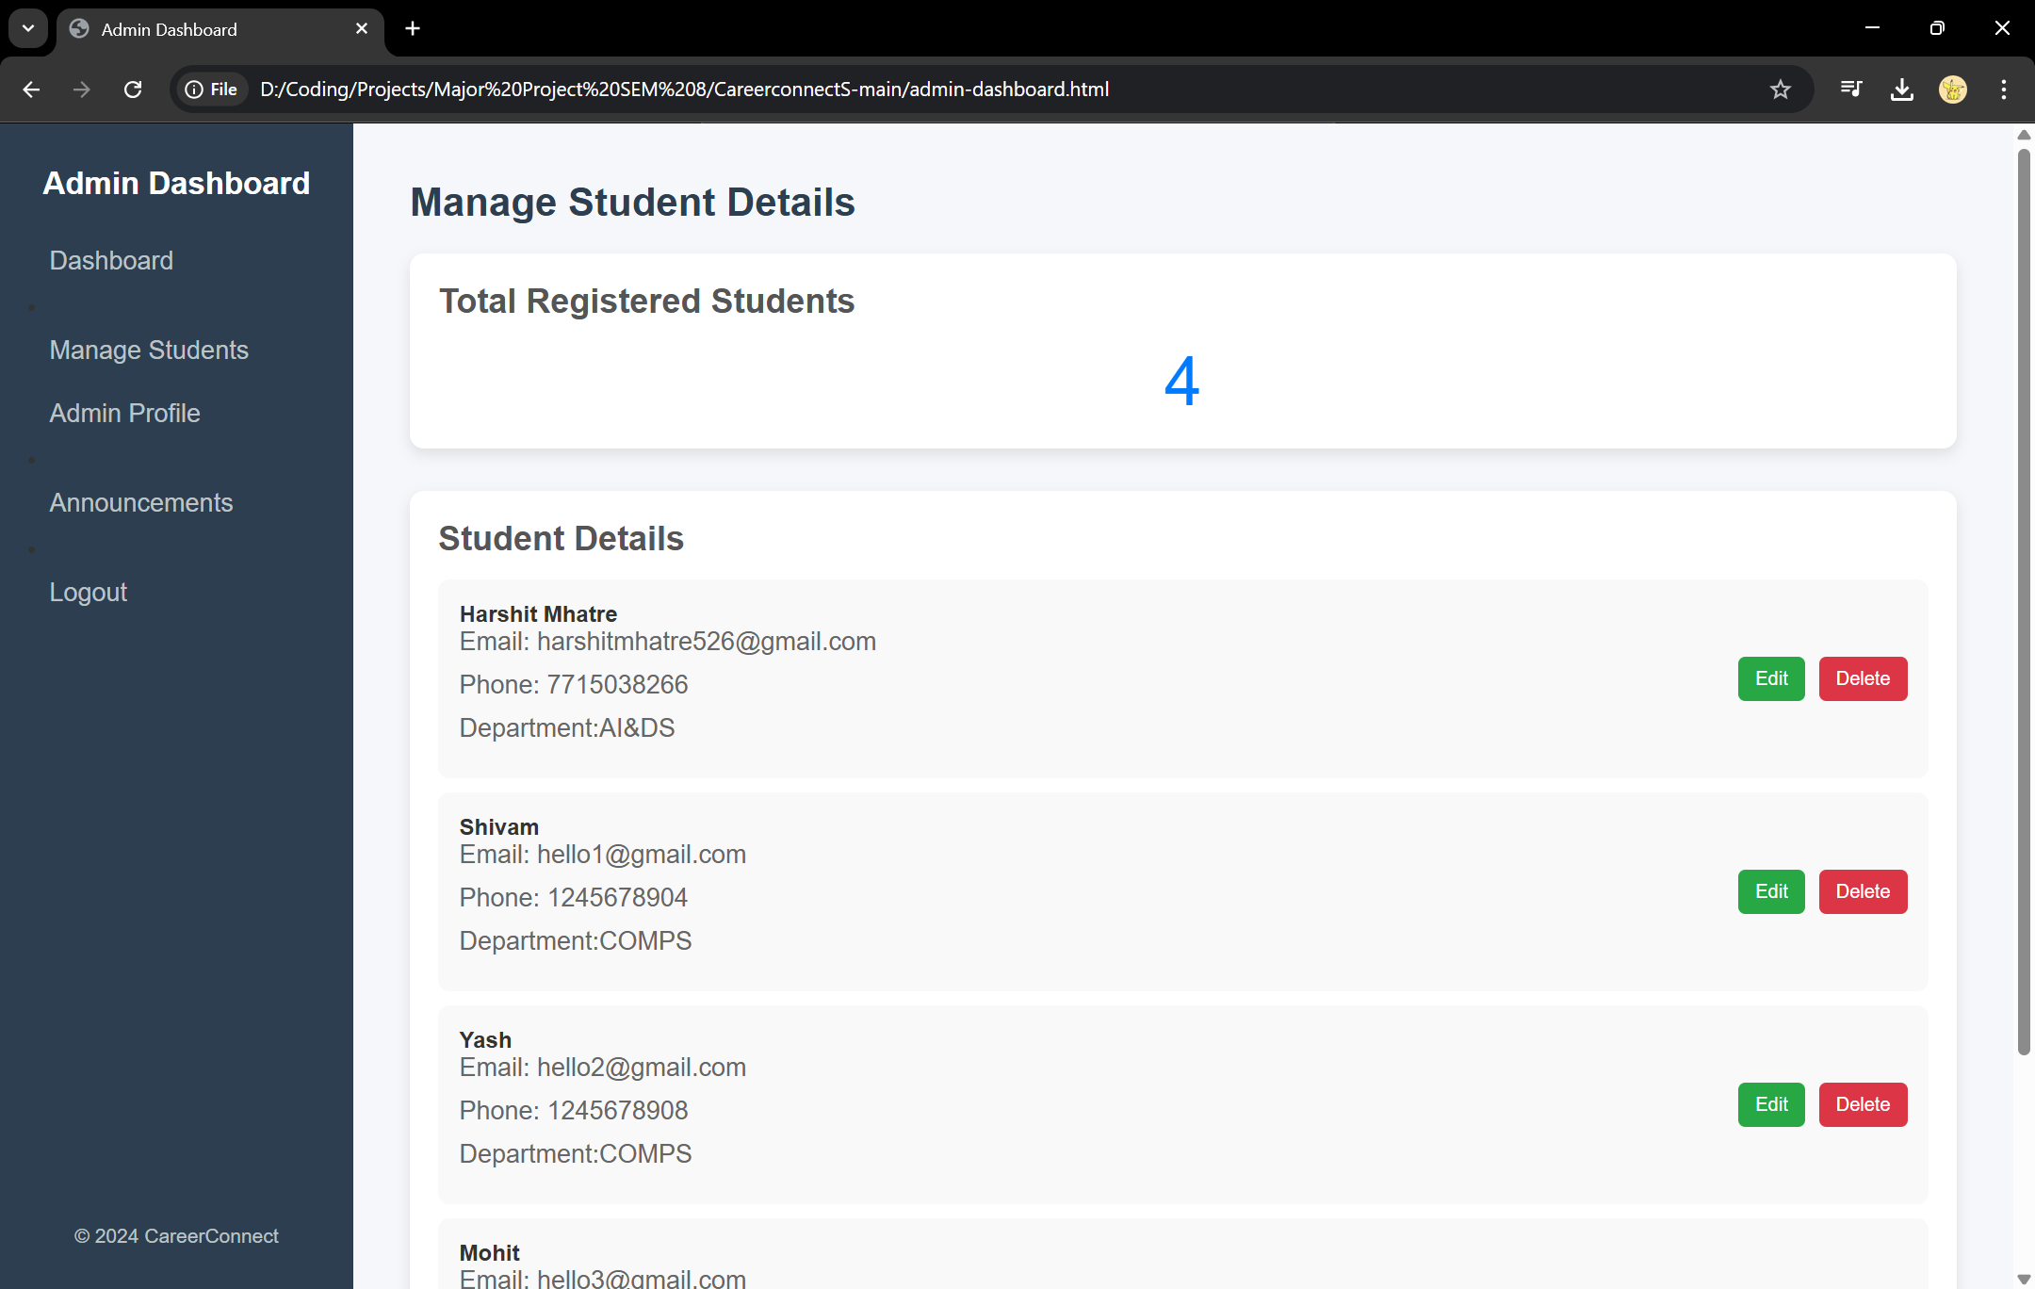
Fig 1.13 Admin dashboard
Fig 1.14 Admin manage students

Slide 29
References
Anand Singh, Aishwarya Shukla, Maulik Sharma, Rahul Yadav, Vidyadhari Singh. “Placement Test Web Portal.” IOSR Journal of Computer Engineering (IOSR-JCE), e-ISSN: 2278-0661, p-ISSN: 2278-8727, pp. 58-61.
Aishwarya Baile, Pratik Sawarkar, Pratik Wankhede. “Implementation of Training and Placement System.” International Journal of Scientific Research in Science and Technology, Online ISSN: 2395-602X, Volume 8, Issue 3, May-June 2021.
Preksha Nigam, Dr. Ashok Yadhav, Mohammad Ahmad. “Placement Hive AI-based Placement Portal.” YMER, ISSN: 0044-0477, Volume 22, Issue 04 (April) – 2023.
Prasanna Kandekar, Manjiri Raut, Shravani Kadam. “SMART PREP: Smart Preparation Web Application for Placements Using Machine Learning.” International Research Journal of Engineering and Technology (IRJET), Volume 11, Issue 03, March 2024.
C. M. Nalayani, Thanga Akilan V, Hariharan S. “Placement Analysis for Students using Machine Learning.” Journal of Information Technology and Digital World, June 2023, Volume 5, Issue 3, Pages 223-227.
Piyush Deore, Pranav Chougule, Atharva Dere. “Placement Automation System For Educational Institutes.” IJCRT, Volume 11, Issue 5, May 2023, ISSN: 2320-2882.

Slide 30
References
Bidyut Das, Mukta Majumder, Santanu Phadikar. “Automatic question generation and answer assessment: a survey.” Research and Practice in Technology Enhanced Learning, 2021, 16:5.
Mr. L. Sivaprasad, E. Giribabu Goud, V. Harshitha. “Real-Time Facial Expression Recognition Using Convolutional Neural Network.” IJCRT, Volume 11, Issue 4, April 2023, ISSN: 2320-2882.
Abhinav Velaga, Vemula Gayathri, Satish Chandran. “Campus Placement Prediction – AI ML.” IJCRT, Volume 12, Issue 3, March 2024, ISSN: 2320-2882.
Dhanashri Anwat, Prajakta Derle, Payal Nagare. “Facial Expression and Sound Analysis for Interview Assessment: An AI-Based Application.” JETIR, April 2024, Volume 11, Issue 4.
Lav Kumar, Karthik Penikalapati, Sudheer Kumar Reddy Gowrigari. “Resume Matching Framework via Ranking and Sorting Using NLP and Deep Learning.” International Research Journal of Modernization in Engineering Technology and Science (IRJMETS), Volume 05, Issue 11, November 2023.
Patlolla Sruthi, P. N. V. K. G. Adithya, MD. Suleman. “Smart Resume Analyser: A Case Study using RNN-based Keyword Extraction.” E3S Web of Conferences, ICMPC 2023, 23, 010 (2023).

